Slide 1
Reserve Margin
Reserve Margin is planned excess of supply capacity that is installed in comparison to the peak load (i.e. in MW).
It avoids shortages in power supply due to unforeseen demand peaks or due to sudden lack of renewable supply.
Notes:
Need to consider requirement for Reserve Margin in long-term energy planning

Slide 2
Reserve Margin
In mathematical terms, it is defined as difference between the total generation capacity and expected peak demand of the year:
Available Reserve Margin (MW) = Α - Β
Available Reserve Margin (%) = (Α - Β) x 100 / Β
Where: Α = Total Generation Capacity (MW)
Β = Expected Peak Demand (MW)
Notes:
Need to consider requirement for Reserve Margin in long-term energy planning

Slide 3
Importance of Reserve Margin
Reserve Margin is a way of ensuring reliability by avoiding shortages in power supply – aim for a higher supply than what may be expected. However this cannot always be ensured:
  Projecting future electricity demand is difficult
  Commissioning of new power plants may take several years
Notes:
Need to consider requirement for Reserve Margin in long-term energy planning

Slide 4
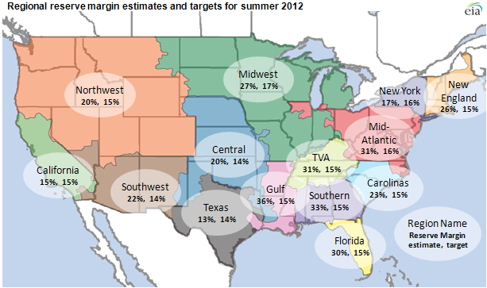
Importance of Reserve Margin
Regional reserve margin estimates and targets for summer 2012.
Source: U.S. Energy Information Administration

Slide 5
Capacity Credits
Not all technologies can contribute to the Reserve Margin to the same degree.
Dispatchable technologies (e.g. gas turbines, coal power plants, storage options etc) typically can contribute up to 100% of their capacity.
Non-dispatchable technologies (e.g. Solar PV, wind turbine etc) contribute to a significantly lower degree in the absence of storage; this varies according to the respective resource availability.
Capacity Credits: measure to what extent each technology can contribute
to the Reserve Margin

Slide 6
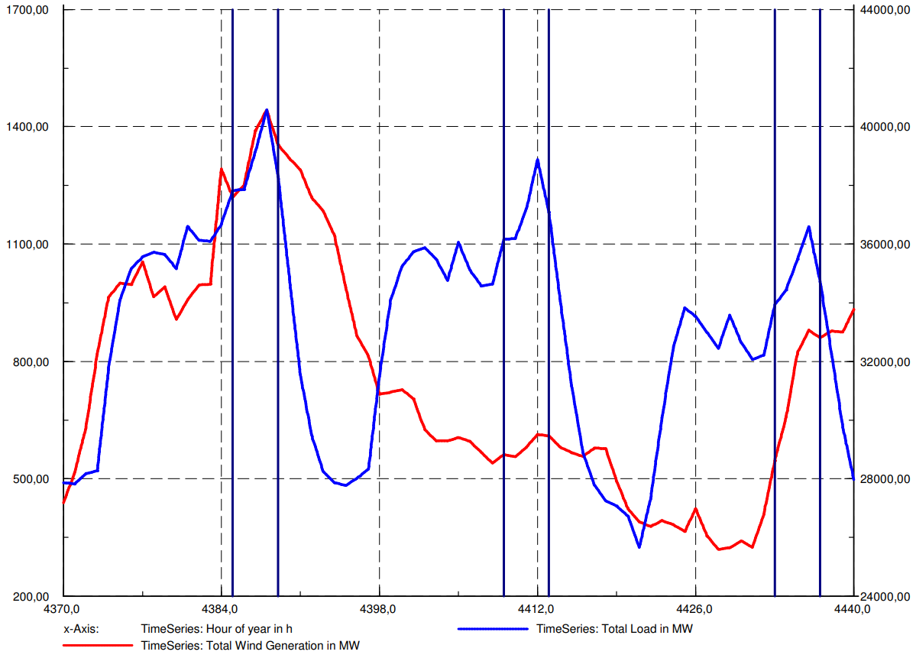
Yearly Wind Generation Variability
(e.g. South Africa)
Source: GIZ
Notes:
The figure shows 3 days in South Africa. Blue is total load in MW (secondary y axis), red shows wind generation in MW (primary y axis). Note the difference in scale between the two y axes.

Slide 7
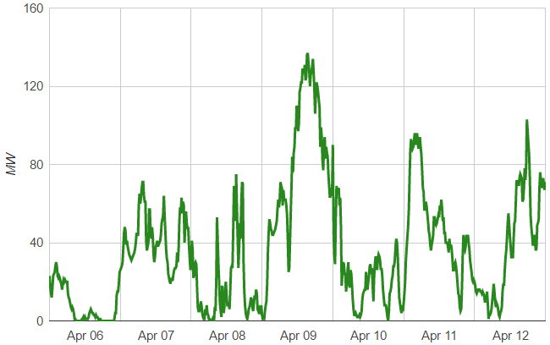
Yearly Wind Generation Variability
(e.g. Cyprus)
Source: Transmission System Operator - Cyprus

Slide 8
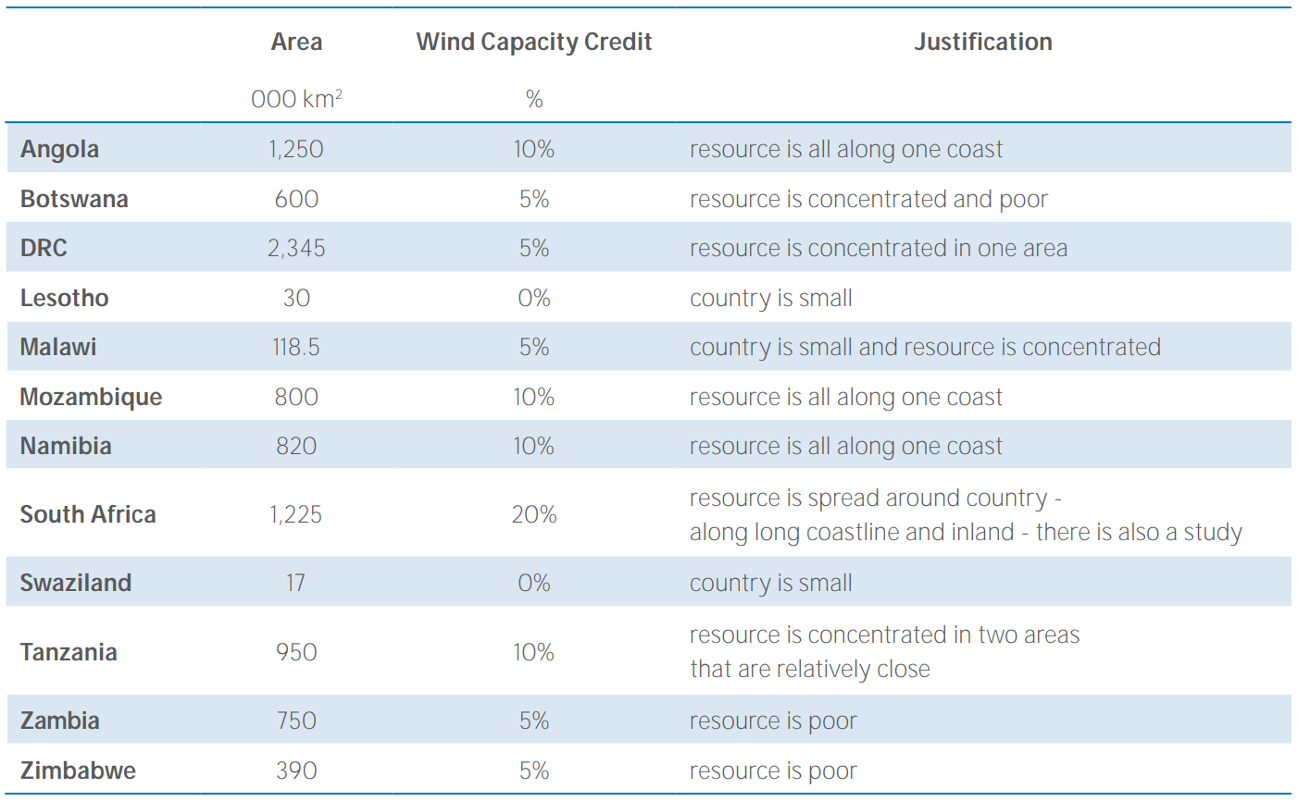
Capacity Credits for Wind
Source: IRENA, 2014

